Slide 1


Slide 2
Queensland CTP
Neil Singleton &
Kylie Horton

Slide 3
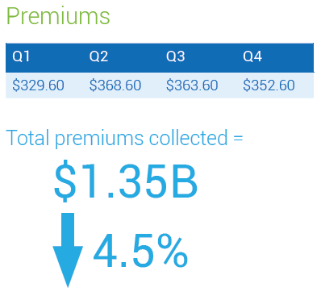

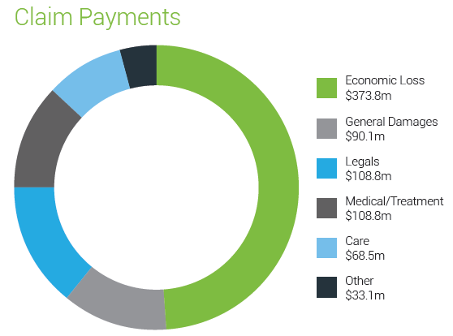
Annual Report / 30 June 2017 data
Total Payments $783m

Slide 4
Premiums….includes NIISQ levy from October 2016
All insurers filed at ceiling for all classes - MAIC has tightened premium assumptions during 2017
Underwriting quarter commencing

Slide 5
Market Share by premium
The slow grind of market share movement continues…
Notes:
Very little change

Slide 6
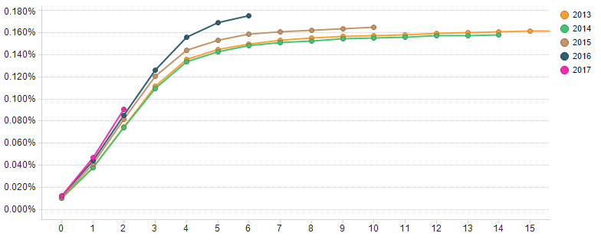
Claim Frequency
Claim frequency by development quarter (Ex WC & IS)
Development quarter

Slide 7
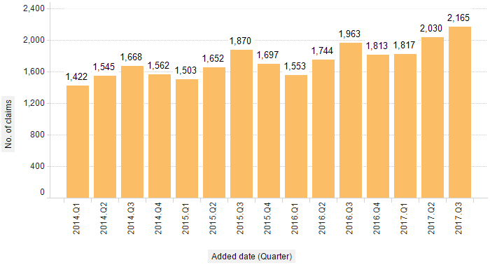
Claims added by quarter
Rising level of new claims…(appears to be minor injury cohort, but injury coding too immature)

Slide 8
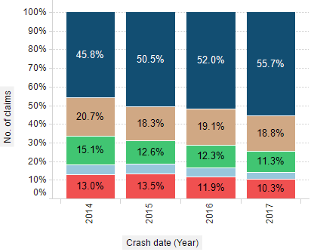

Claim crash circumstance
Rising trend in ‘same direction’ crashes and at lower speeds – driver distraction?

Slide 9
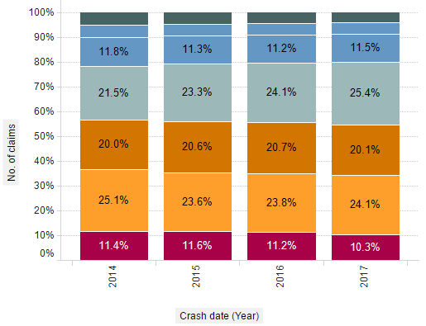
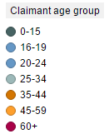
Claims by claimant age group
No material changes overall – only one segment (25-34yo) has seen movement
Notes:
A small increase in 25-34 age group

Slide 10
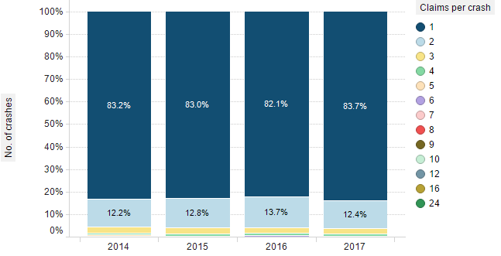
Claims per accident
No observable trends or changes….
Crash date (year)

Slide 11
Finalised Severity 1Y Average claim size
Experience improving but varies by insurers – represents an opportunity for improvement

Slide 12
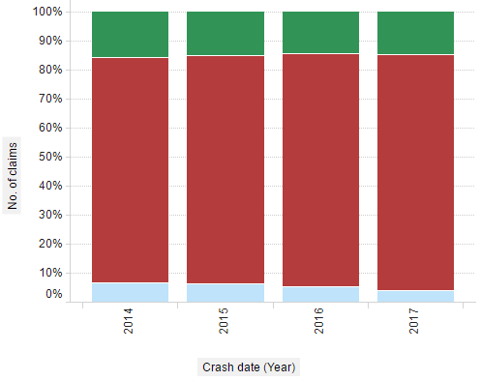
Legal firm representation
Data issue addressed – but not in time to prevent the ‘facts’ making the story…
Direct
QLD legal
Interstate legal
Fees rise to fund compo racket
The Courier Mail Brisbane, 27 Aug 2017
MOTORISTS face third-party insurance premium hikes as NSW-based lawyers and scammers drive a surge in claims against Queensland’s compulsory scheme.
Notes:
NA = Direct

Slide 13
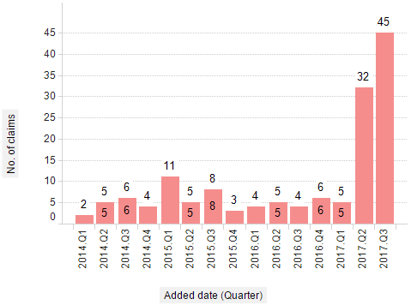
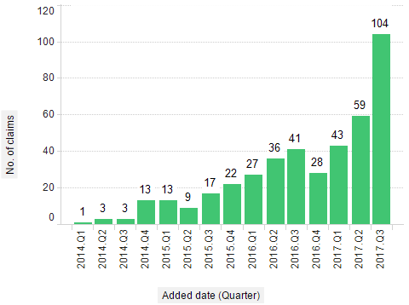
Legal firm trends
MAIC and licensed insurers monitoring trends – some explainable, others may warrant closer analysis

Slide 14
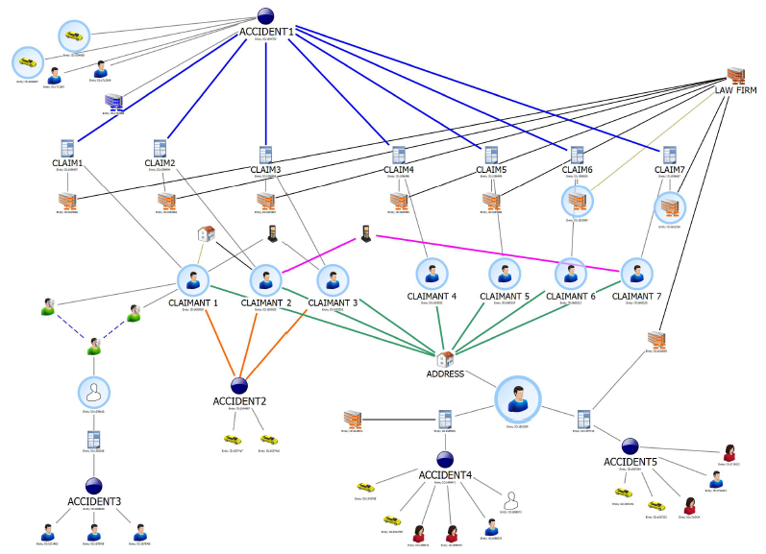
Claim farming, claims fraud
Cold, warm and hot….the evolving models of claim farming
Monitoring changes in law firm activity/new claims volumes
Geographic focus
Exploring reforms with Department of Justice and Attorney General
Working with insurers on areas of focus, increased monitoring and additional analytical capabilities

Slide 15
2016 CTP Scheme Review
CTP Scheme Review
IMPLEMENT NOW
January 17
July 17
December 17
Take action to address high insurer profits in the scheme
Improve consumer awareness of choice of CTP insurer at both renewal and when purchasing a vehicle
Develop appropriate benchmarks to enable enhanced assessment of scheme performance around issues of affordability, efficiency and satisfaction
Implement a legal fee reporting model to allow for greater transparency of scheme efficiency
Eliminate areas of overlap and lack of clarity in the current prudential supervision arrangements
Strengthen insurer performance monitoring, benchmarking and reporting
Make information on scheme trends and performance more readily available to stakeholders
Premium Savings
Tighter premium assumptions
Actively monitor premium inputs
Explore limited risk rating
Actuarial analysis/preparation
Discussion paper released
Assess options and report
Online renewal
Explore options
Analyse pros/cons & costing
Road map options and report
Improve consumer awareness
Market research
Creative campaign options
Implement creative strategy
Insurer performance monitoring
Actuarial analysis
Establish framework
Explore
Prudential supervision and compliance
Regulatory body meetings
Investigate limited risk rating to identify potential opportunities for improving price competition and affordability
Move the CTP renewal process online as soon as practicable noting the practical limitations associated with the current system
Enhance governance by amending the Motor Accident Insurance Act 1994 to require a review of the scheme at least every five years.
Amend the Motor Accident Insurance Act 1994 to remove reference to the Affordability Index and Average Weekly Earnings as a measure of scheme affordability
Amend the Motor Accident Insurance Act 1994 to establish an appropriate
hierarchy of regulatory responses to licence compliance breaches
Develop options
Legislative change?
Legal costs monitoring
Actuarial report - sample selection
QLS/ALA engagement
Implementation
Scheme trends & performance reporting
Develop insights and trend analysis reports
On-line/social media
Key Outcomes
Scheme insights & reporting
Brief to Treasurer on exploring options
Publicly available material, information and reports
Monitor
Retain a private underwriting model, noting opportunities for improvement
Monitor scheme circumstances and in the event of significant adverse change in scheme circumstances, examine a public underwriting model
Retain the community rating model and vehicle class filing system
Retain the current CTP premium collection model
Retain the current Nominal Defendant scheme
Retain the common law defence of inevitable accidents
Do not introduce no-fault cover for children at this time

Slide 16

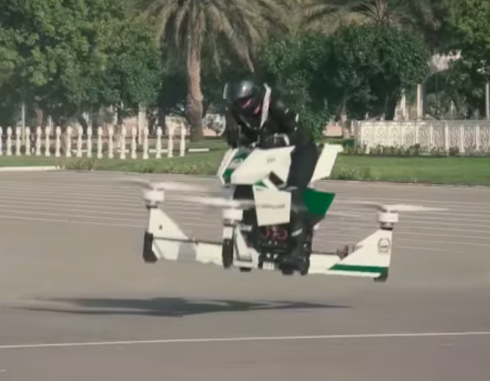
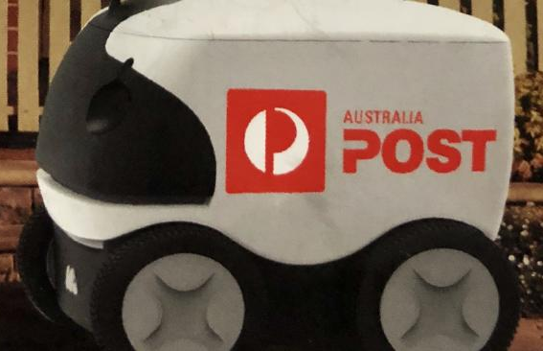
Looking forward
Autonomous vehicle reforms – complex doesn’t begin to describe it
Where does the road start and end… (being provocative)

Slide 17
What’s coming up
Scheme Review actions
Determine next steps based on government priorities
Monitor ride booking vehicle trends and experience
NHVL, NTC reforms continue to progress
Continued focus on claims fraud and claim farming
Increasing sophistication and resourcing in scheme monitoring

Slide 18

Welcome to Queensland – Home of the State of Origin

