Slide 1
Queensland CTP Scheme:
Claim frequency on the rise
Kylie Horton General Manager
Motor Accident Insurance Commission
9 March 2018

Slide 2
Claim frequency
Frequency has unexpectedly increased over past three years after steady reduction

Slide 3
Claim profile
Increasing frequency of represented minor injury claims (1Y)
Claims by injury severity (1yr development)

Slide 4
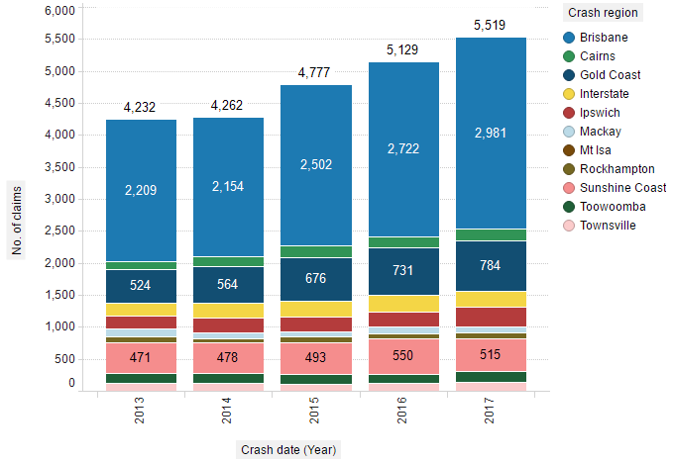
Claim profile
Increasing frequency in South East Queensland
Claims by crash region (1yr development)

Slide 5
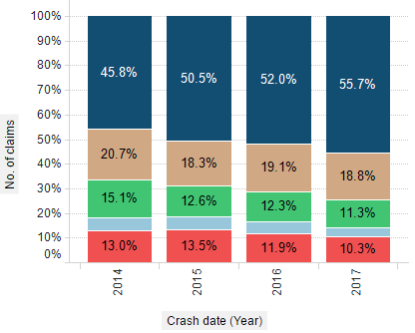
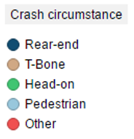
Crash Causation
Rising trend in ‘same direction’ nose to tail crashes (and anecdotally at lower speeds)

Slide 6
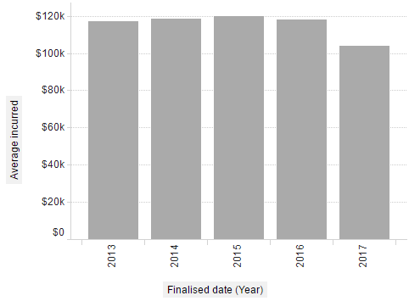
Average claim size
Overall average claim size – All severities

Slide 7
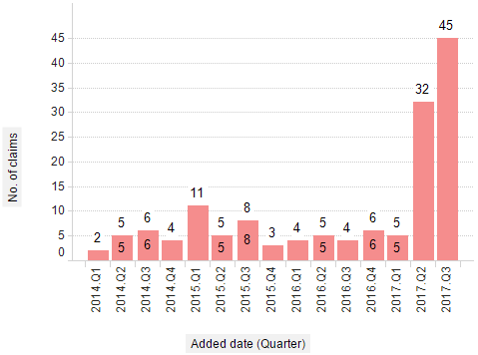
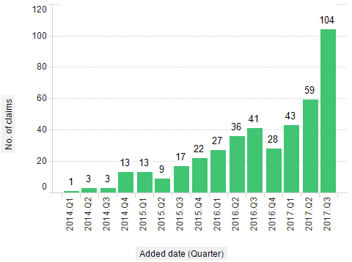
MAIC monitoring recent trends
Changing landscape and rapid rise of several law firms

Slide 8
Scheme issues – Claim Farming
Actions taken
Richard Douglas QC engagement
Working with DJAG on reform options – in conjunction with QLS and ALA
Public complaints to MAIC and to ACCC re claim farmer harassment
MAIC website and media activity to raise consumer awareness….’just hang up’
MAIC concerns
Members of the public are being misled
Anecdotal evidence of people being scripted/led by claim farmers
The claimant faces a fraud prosecution if they make false statements
Morphing to ‘marketing services’…

Slide 9
Scheme issues – Claim Farming/Marketing services
Upping the ante….one ‘marketing service’ has shared their referral rates

Slide 10
‘Marketing services’…order your clients by 5.00pm….

Slide 11
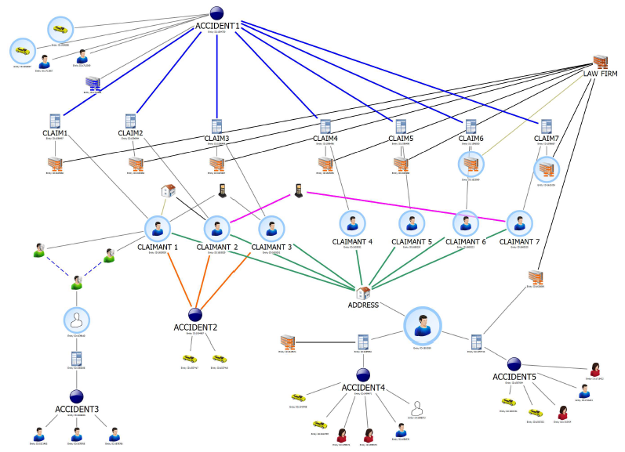
Scheme experience – Fraud
The ‘NSW disease’ is coming to Queensland!!
Insurers concerned NSW CTP reforms will drive bad behaviour North
MAIC engaged consultants to undertake data and claims analysis
No evidence of systematic fraud but some cases warranted further review
Fraud training for CTP claims managers
MAIC joining Inter Agency Fraud Forum
National forum of scheme managers, Government Agencies, Police

Slide 12
Stepping things up
MAIC message to insurers –
‘Manage genuine claims appropriately. Manage unmeritorious claims firmly’
MAIC increasing resources
Greater analysis and monitoring capability
Alerting insurers to adverse issues or trends at a scheme level
Increased scheme transparency, data sharing, reporting
Removing unmeritorious claims will strengthen scheme stability
Collaboration with QLS, ALA and Insurers is an important element to preserving scheme stability

