Slide 1
Compulsory Third Party Insurance Scheme Update
2018 State Taxi Conference: Sunshine Coast
12 September 2018
Neil Singleton, Insurance Commissioner, MAIC

Slide 2

Presentation Overview
CTP
National CTP Overview
Taxi experience
Maxi-Taxis – a quick look
Ride booking vehicles
Concluding remarks

Slide 3
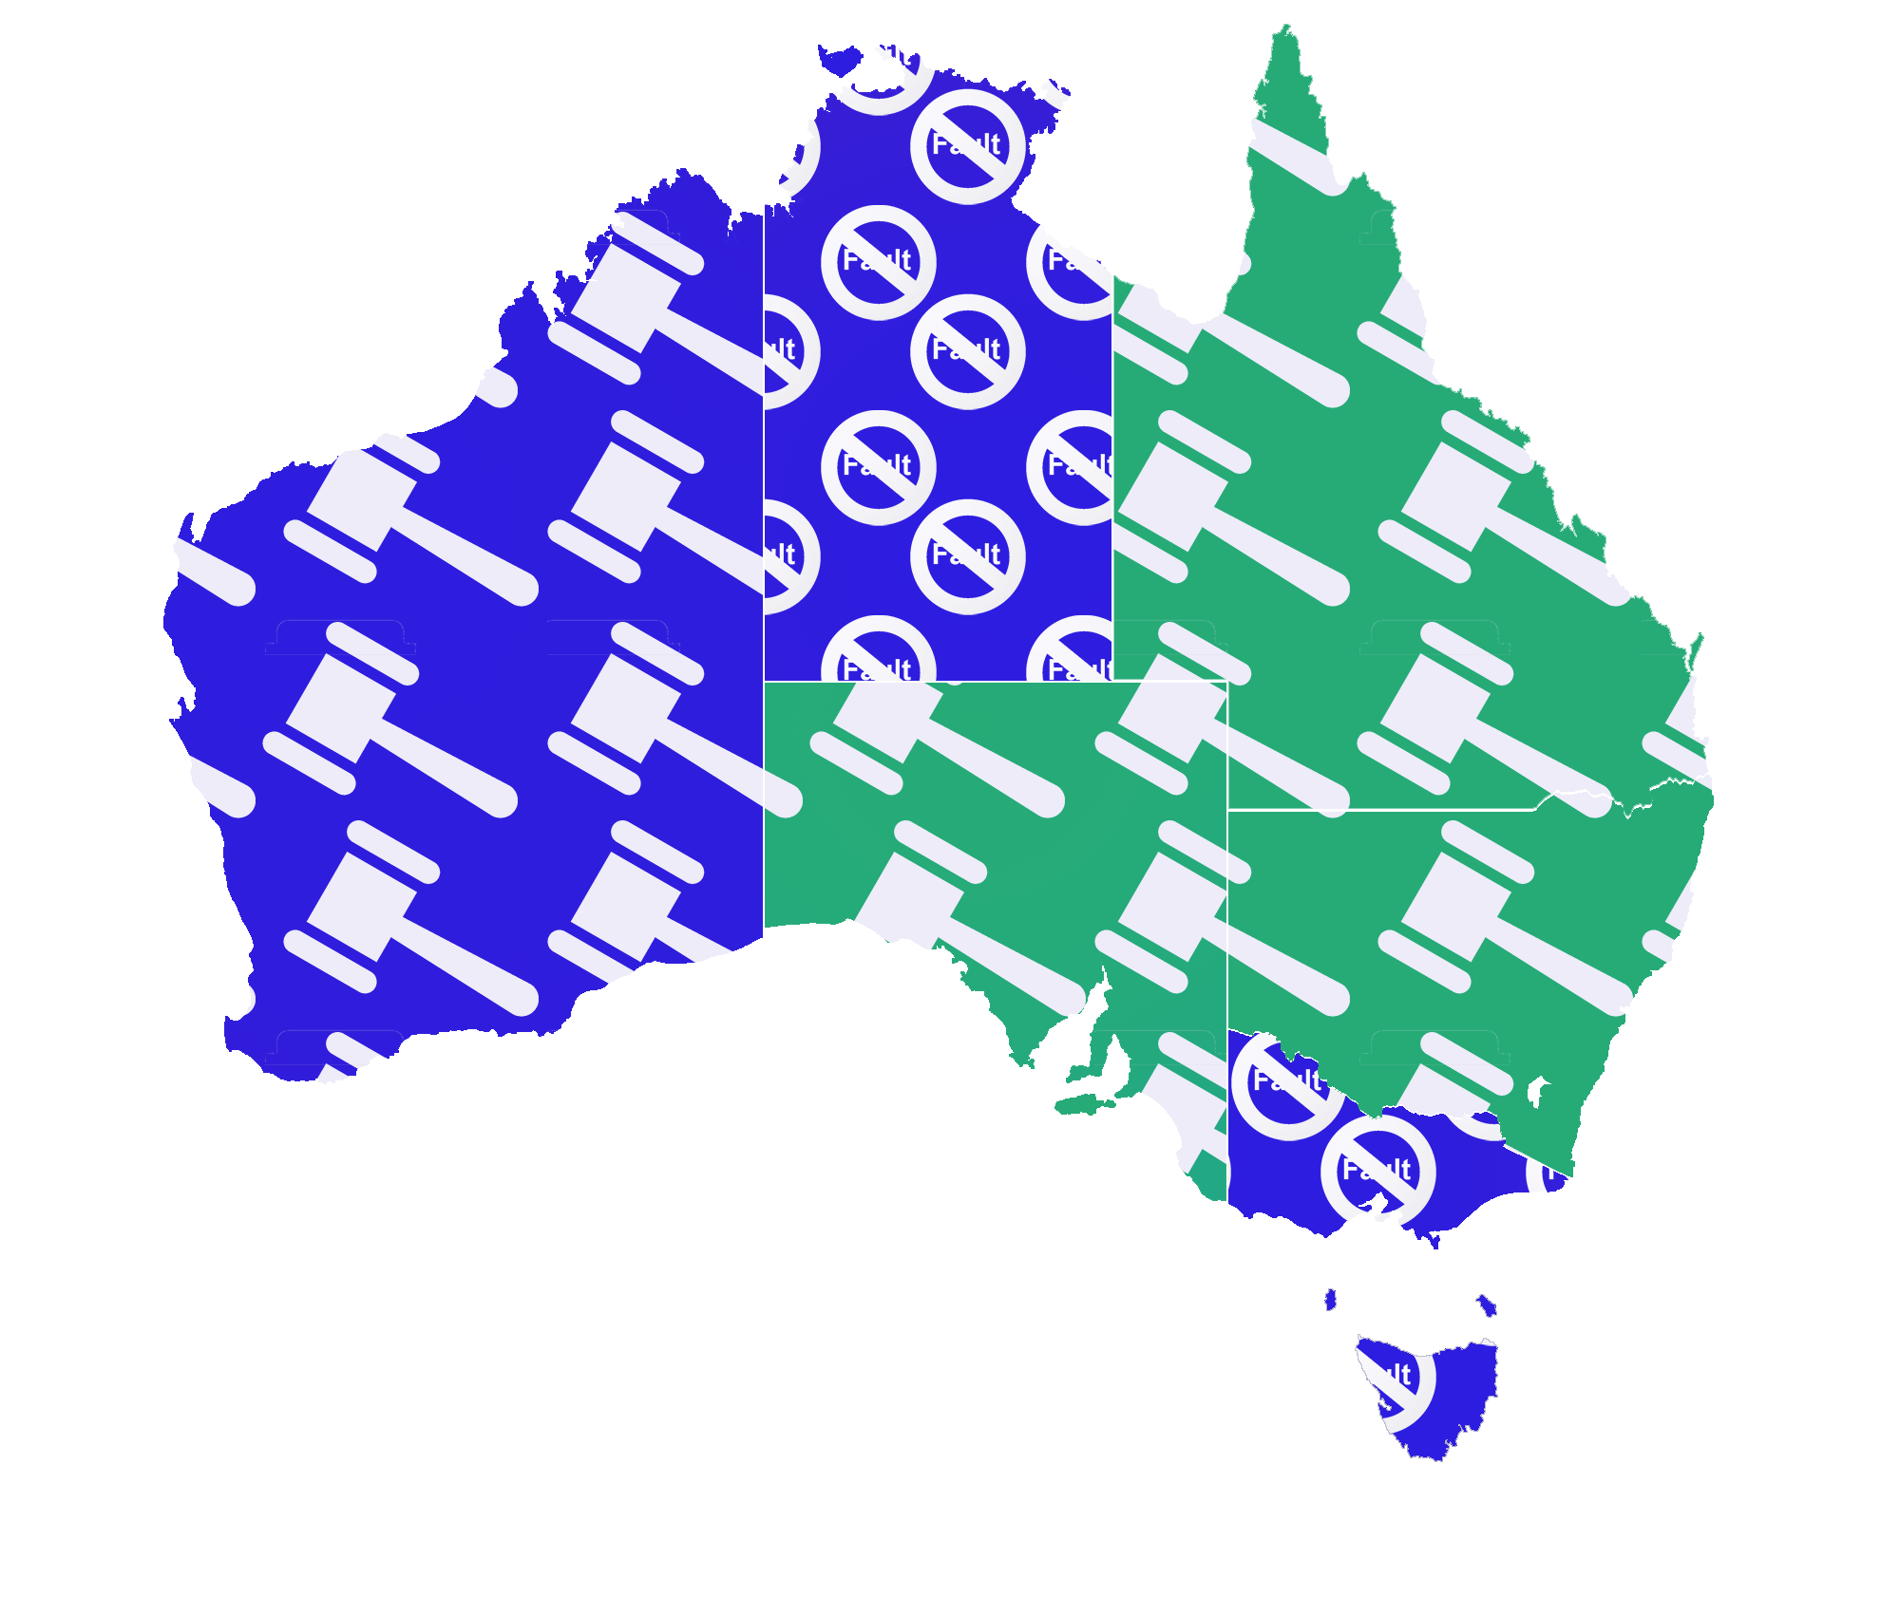
NT
No-fault
Government underwritten
Queensland
Fault-based
Common law
Private underwriting
NSW
Fault-based
Common law
Private underwriting
WA
Fault-based
Government underwritten
ACT
Fault-based
Common law
Private underwriting
SA
Fault-based
Common law
Private underwriting
VIC
No-fault
Government underwritten
TAS
No-fault
Government underwritten

Slide 4
Taxi premiums nationally…..
Taxi premiums vary nationally – based on a variety of factors such as claims experience, scheme design, claimant benefits
NSW reflects maximum metro premium. Alternative option is to pay a base premium plus five cents per km travelled

Slide 5
Queensland CTP premium – a positive story
Premium relativity reduced from peak of 22 down to 16 times Class 1
Current premium = $4,030
Analysis excludes maxi-taxis

Slide 6
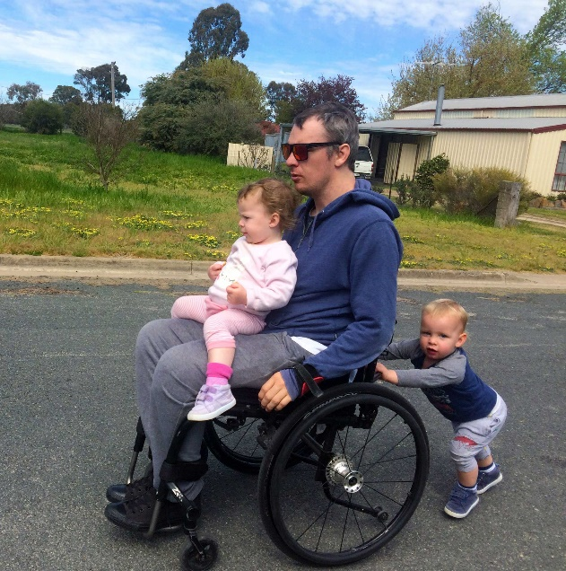






National Injury Insurance Scheme Queensland (NIISQ)
A no-fault Scheme providing necessary and reasonable lifetime treatment, care and support to those who sustain eligible serious personal injuries in a motor vehicle crash in Queensland, on or after 1 July 2016.
Covers serious personal injury arising from registered vehicle road crash regardless of fault
Permanent spinal cord injuries
Traumatic brain injuries
Multiple or high-level limb amputations
NIISQ provides protection to seriously injured people regardless of their role in a crash.
Permanent injury to the brachial plexus
Permanent legal blindness
Severe burns
www.niis.qld.gov.au
Class 3: NIISQ levy $566.60 per annum. Will collect around $1.5million per annum

Slide 7
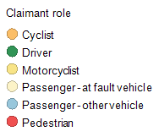
Queensland Taxi Crash Statistics 2017…..50 claims received
Driver
17
17
Pedestrian
13
13
Passenger -
8
8
at fault
vehicle
Claimant Role
Cyclist
6
6
Passenger -
4
4
other vehicle
Motorcyclist
2
2
0
2
4
6
8
10
12
14
16
18
No. of claims

Slide 8
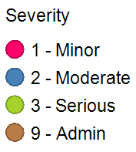
Class 3 accidents – by severity of claimant injury
Tuesday
7
3
10
Thursday
5
4
9
Wednesday
3
2
3
8
Monday
3
2
1
6
Day of Week
Saturday
5
1
6
Sunday
3
1
4
Friday
2
2
0
1
2
3
4
5
6
7
8
9
10
No. of crashes

Slide 9
Class 3 accidents with pedestrians….focusing on a specific cohort of claims
Helping taxi drivers reduce incidence of crashes with pedestrians will improve safety outcomes

Slide 10
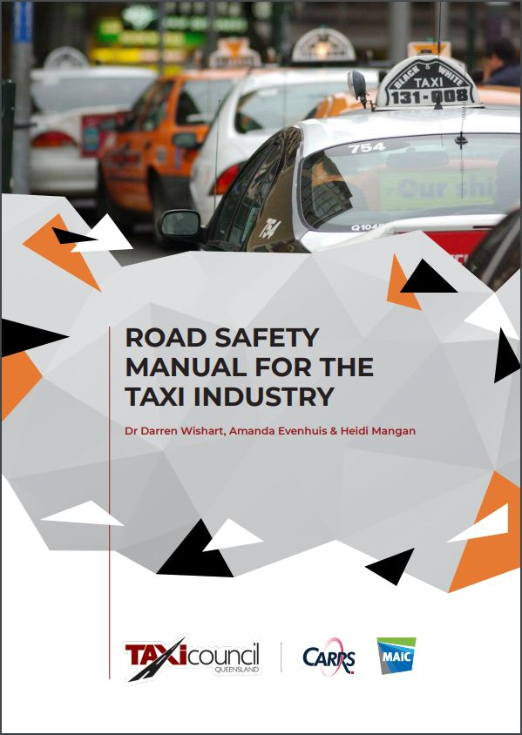
Actions to support improved road safety outcomes for taxis…
MAIC funded research analysis - identify opportunities to improve taxi road safety outcomes
Resulted in preparation of Road Safety Manual…..available to all taxi operators
Currently exploring further opportunities in collaboration with TCQ
CTP claims are ‘long-tailed’ with average life around three to four years.
Creates uncertainty about how quickly the benefit of safety initiatives can be seen

Slide 11
Class 3 accidents with pedestrians….focusing on a specific cohort of claims
Pedestrians unpredictable, drunk, aggressive
Pedestrians put themselves in danger but taxi blamed?
Drivers tired towards end of shift, not concentrating?
Undertake claim file reviews – look at the specifics of the crashes/claims?
Identify what could be done differently to anticipate and prevent incidents
Evidence
Action
Outcome

Slide 12
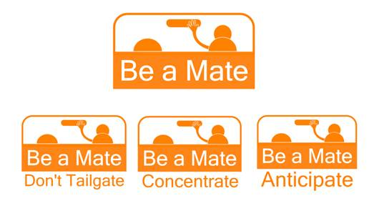
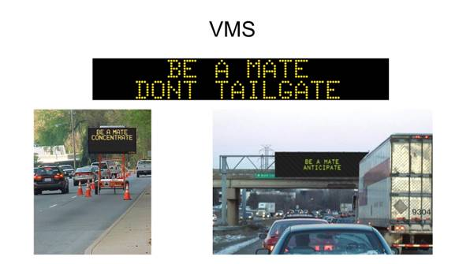
Class 3 ‘same direction’ crashes
Distracted driving…mobile phones
Driving too close, vehicle braking distances?
Looking at initiatives to increase public awareness
Explore factors that are specific to taxi drivers?
Evidence
Action
Outcome

Slide 13

Alternative models: Roll Class 3 into Class 1
$700,000 premium pool collected if Class 3 rolled into Class 1
$10.5m premium pool required to cover crashes with Class 3
Outstanding $9.8m
Licensed insurers have raised strong concerns about any such change given the significant cross-subsidisation that would arise.
The claim cost doesn’t go away simply by moving vehicles to a different Class
Still need to maintain overall premium sufficiency
Requires cross subsidization

Slide 14

Alternative models: Risk based system
Regional or Geographic zone based premiums
Owner-driver versus fleet vehicles
Usage based premiums – different rates for hailed, in use but vacant, not in use
Exposure based premiums
Individual premiums might change under various options but the overall ‘pool’ still needs to remain sufficient
Likely to result in premium volatility for each sub-set based on even modest changes in claims experience

Slide 15
A quick look at Maxi Taxis…
Vehicle Classes 10A or 11 based on size/seating capacity
Class | Number of maxi taxis | Overall Class Size
10A | 66 | 2,734
11 | 641 | 6,839
Total | 707 | 9,573
Class | Quarter commencing 1 Jul 2018 | Quarter commencing 1 Oct 2018
10A | $914.40 | $904.80
11 | $994.80 | $985.20
Premium based on experience of all vehicles in the Class…not just maxi taxis

Slide 16
Ride-booking premiums nationally
Approach to pricing and premium factors varies by jurisdiction.
NSW charge base premium (vehicle class) plus 10 cents per km when booked….uncapped.
All other jurisdictions have a set premium but may have geographic zone pricing.
Ride booking vehicles as a Class are relatively new – limited claims experience
(Class 26 October quarter premium $566.60)

Slide 17
Ride-booking – growth since Class 26 inception
Class 26 showing steady growth – but yet to have a full year’s experience
Claims lodged to date are slightly lower than premium expectations…..but very early days

Slide 18
Concluding Remarks
Comparing premiums across jurisdictions is not a simple exercise.
All jurisdictions classify taxis and ride-booking vehicles separately
NSW exposure based model will be watched closely….but cautiously
Queensland ride-booking premiums and taxi premiums will evolve in response to claims experience
MAIC remains committed to supporting TCQ in continuing to improve CTP claims experience.
TCQ is an important stakeholder in the Queensland CTP scheme

Slide 19
Thank you

